Slide 1
Practical#12
CRC MODELING

Slide 2
CRC(Class Responsibility Collaborator) CARDS
Used in the design of OO systems.
An index card used to represent
A class
Responsibilities of the class and
Interactions between classes
These cards are creative approach to object oriented modeling

Slide 3
Use CRC cards design the system as a team.
The biggest value of CRC cards is to allow people to break away from the procedural mode of thought and more fully appreciate object technology.
CRC Cards allow entire project teams to contribute to the design.
The more people the greater the number of good ideas incorporated.

Slide 4
Individual CRC Cards are used to represent objects. The class of the object can be written at the top of the card, responsibilities listed down the left side, collaborating classes are listed to the right of each responsibility.

Slide 5
Terminology
Class: The blueprint for an object.
Collaboration: The process whereby several objects cooperate to provide some higher-level behavior.
Object: Something that can do things. An object has state, behavior and identity.
Responsibility: Obligation of an object to provide a certain behavior.

Slide 6
Group for CRC Session
The ideal group size for CRC session is five or six people.
More people more disagreements.
Who should be in the group?
One object oriented technology facilitator
Two domain (business) experts.
The rest should be developers

Slide 7
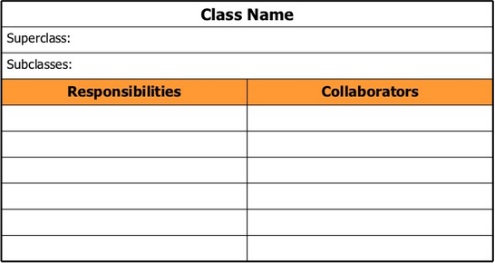
CARD LAYOUT

Slide 8
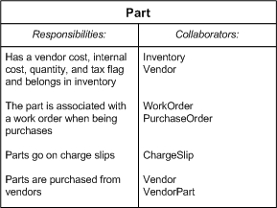
Example CRC card

Slide 9
Conclusion
A fun, effective way to work through OO analysis.
Makes the art of identifying classes, responsibilities and collaborations simple

Slide 10
LAB TASK
Design CRC cards on any example system. (Describe the scenario first and then identify all classes, make cards for just three of them with proper responsibilities)
Deadline:

